Slide 1


Python Workshop Chapter 1 - Introduction to Python data type and objects.
Presentation by –
Nidhi Ghorpade

Slide 2
A) Python Data Types
Numeric Data types : There are two main numeric datatypes ->
Integer (int) – Integers are basically whole numbers.
For example – 3, 6, 200, 5000
Float (float) – Floating point numbers are numbers with decimals.
For example – 3.5, 5.67, 100.01
String (str) – Ordered sequences of characters.
For example – “Nidhi” ‘hello’ “2000”

Slide 3
B)Declaring variables with assignment operators.
Rules for variable names –
Names cannot start with numbers.
They cannot have spaces. Instead use _.
Cannot use special characters.
Python uses Dynamic Typing – Variables in Python get their type depending on what you assign to them.
That also means you can reassign variables to different datatypes.

Slide 4
B)Declaring variables with assignment operators.
n_age = 23 value
variable name assignment operator
This is not like math where x=y is same as y=x.
x = y is same as y = x in Math. But not in programming languages

Slide 5
C) Numbers and arithmetic operators.
Numbers can be int or float as discussed earlier.
Python has arithmetic operators most of which follow the normal rule of mathematics.
Other operators can be found on the faq page.
SYMBOL | OPERATION
+ | Addition
- | Subtraction
* | Multiplication
/ | Division
** | Exponention
% | (Modulo) Remainder after dividing
// | Divides and rounds down to nearest integers.

Slide 6
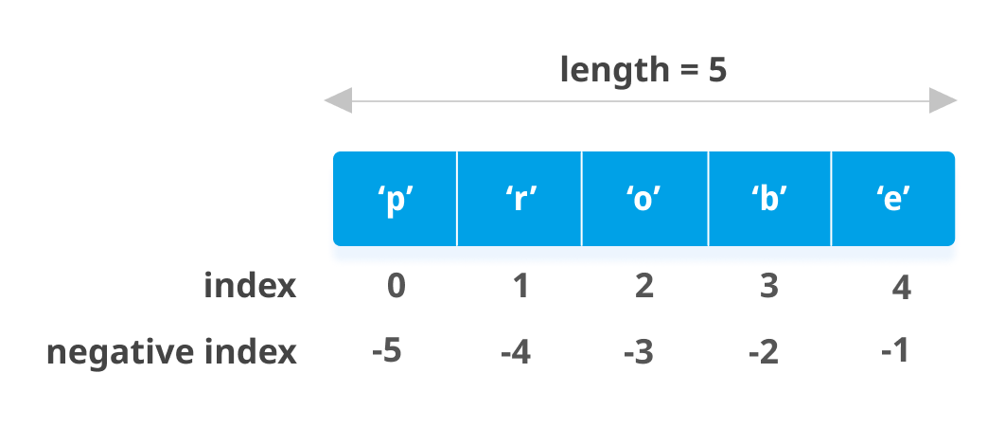
D) Introduction to strings and Indexing and Slicing.
Strings are sequences of characters, using the syntax either single quotes or double quotes.
“Hello”, ‘I love python’, “Let’s get this”.
Indexing helps you grab a single character from a string.
These actions use [] to grab characters.

Slide 7
E) Introduction to strings and Indexing and Slicing.
Slicing helps you grab subsection of multiple characters.
Syntax – [start:stop:step]
Start – numerical index of the slice start.
Stop – Index you will go upto (but not include).
Step – Size of the jump you take.

Slide 8
G)Print formatting with strings.
Would be covered in examples.
H) Split () method.
Would be covered in examples.

Slide 9
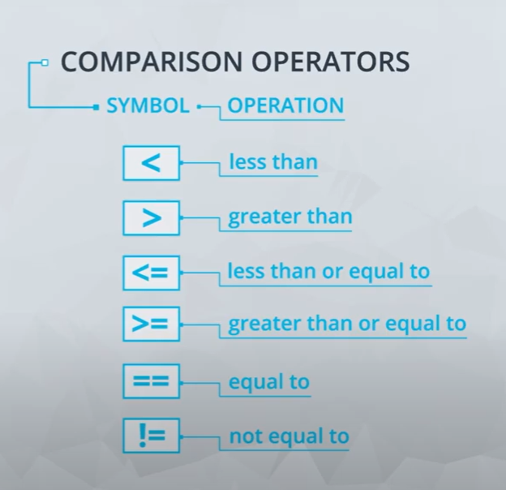
I)Boolean and Comparison operators.
Booleans are operators that allow you to convey true of false statements.
We won’t use them directly as we mostly use them with comparison and logical operators to return Boolean values.
We will see a few examples.
Comparison operators –
Used to compare two values in different ways.

Slide 10
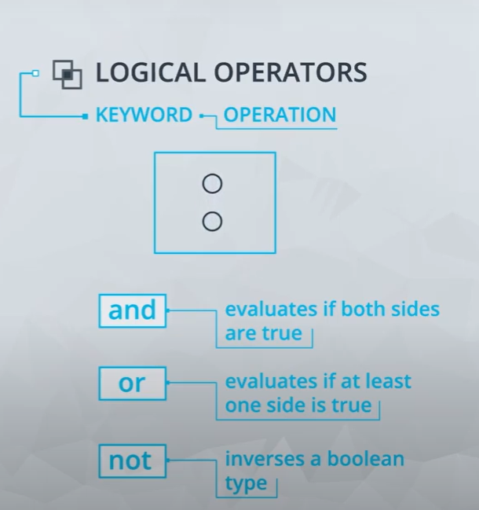
I)Boolean and Comparison operators.
Logical operators –
Used to compare logic for two values in different ways.

Slide 11
Please leave your questions and comments on the Study Buddy Slack channel! Or email me at ghorpade.nidhi@yahoo.com
Thanks!

